Slide 1
Theory of Computation TA Session

Slide 2
Overview
Introduction to regular expression libraries
Regular Expression Tutorial
Example Code

Slide 3
Introduction to regular expression libraries

Slide 4
Library Introduction
PCRE – Perl Compatible Regular Expressions
re(Python) – Regular expression Python package
Regex – regular expression library supported by std in cpp
For beginners, re(Python) and Regex are recommended

Slide 5
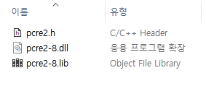
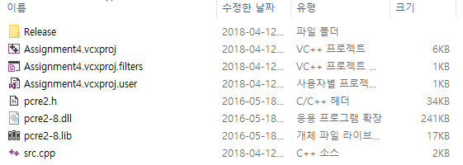
Setup – PCRE2
Download PCRE_Library.zip from Blackboard
Unzip, and copy 3 files (pcre2.h, pcre2-8.dll, pcre2-8.lib) into the solution directory of your Visual Studio project

Slide 6
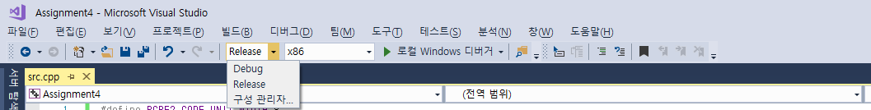
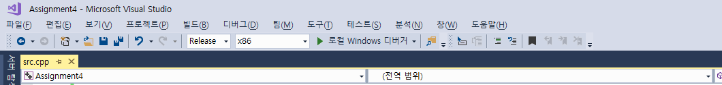
Setup – PCRE2
Please change the mode option to the release mode, not a debug mode

Slide 7
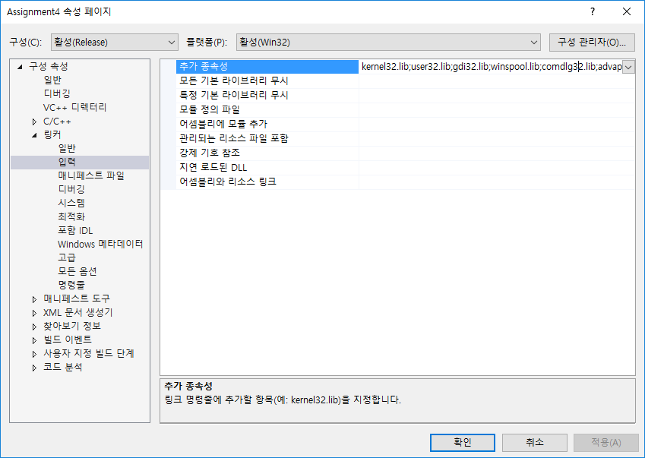
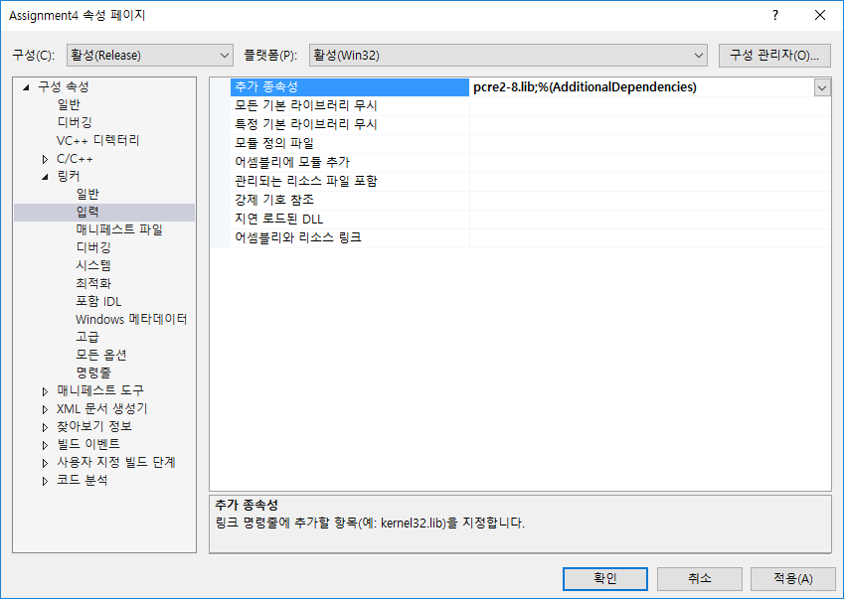
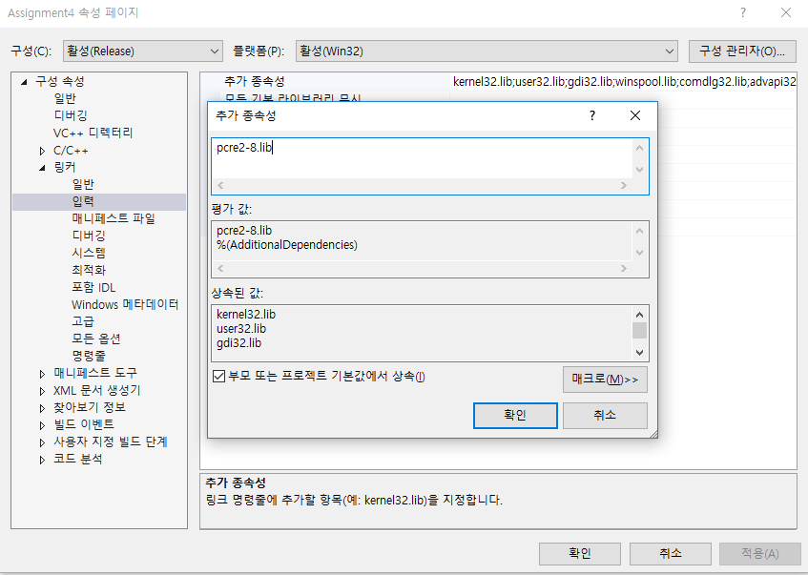
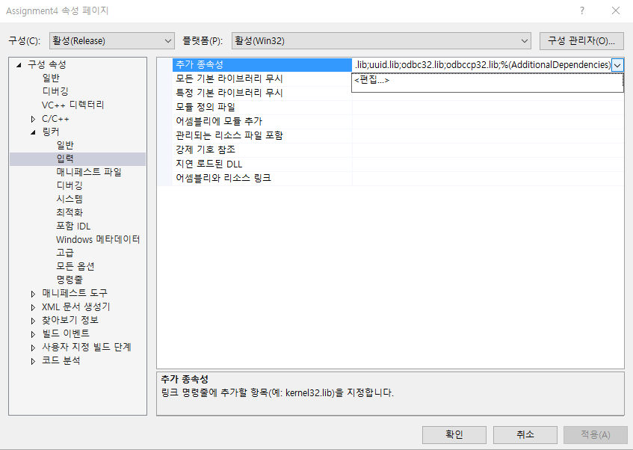
Setup – PCRE2
Go to Project Configuration Properties -> Linker -> Input -> Additional Dependencies, and add pcre2-8.lib

Slide 8
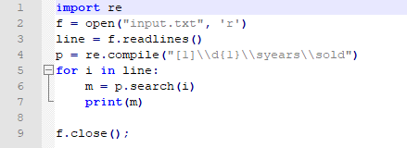
Setup – re(Python)
Import re module with “import re”, and you can use regular expression with re.~~

Slide 9
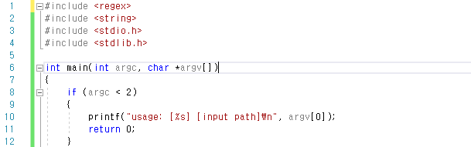
Setup - regex
Include regex library to your visual studio project with “#include <regex>”, and you can use regular expression functions with std::regex.

Slide 10
Regular Expression Tutorial

Slide 11
Patterns
Reference) https://www.debuggex.com/cheatsheet/regex/pcre
Base character classes
\w – any word character. Same as [a-zA-Z0-9_]
\W – any non-word character
\s – whitespace character
\S – any non whitespace character
\d – digits. Same as [0-9]
\D – any non digit character
Quantifiers
n* – zero or more of n
n+ – one or more of n
n? – zero or one occurrences of n
{n} – n occurrences exactly
{n,} – at least n occurrences
{,m} – at most m occurrences
{n, m} – between n and m occurrences (inclusive)
Meta characters
[ – start character class definition
] – end character class definition
| – alternates, e.g., (a|b) matches a or b

Slide 12
Patterns (examples)
Examples
Pattern: \w+
String
“2016” – match
“1q2w3e4r” – match
Pattern: \d==\d
string:
“0==0” – match
“K==k” – doesn’t match
Pattern: \w{3,5}\s*\d+\w+\s\w*
String
“The 30th anniversary” – match
“Most people in the world” – doesn’t match
Pattern: [1-5][d-g]*
String
“1dfdgfdfdgfdgfgdfdfgdf” – match
“12dfdfdfdfdf” – doesn’t match
Pattern: [1]\d{1}\syears\sold
string:
“10 years old” – match
“16 years old” – match
“26 years old” – doesn’t match
“15 yearsold” – doesn’t match

Slide 13
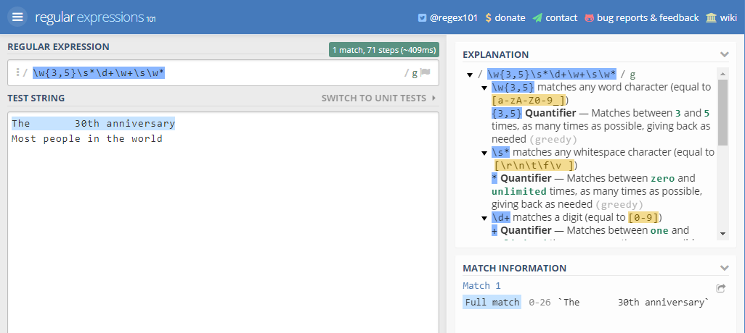
Patterns (playground)
Reference) https://regex101.com/

Slide 14
Example Code

Slide 15
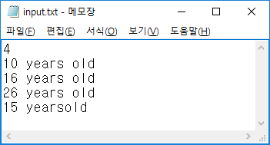
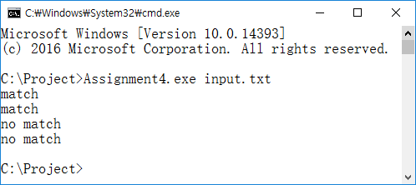

Example code explanation
Example code used regular expression “[1]\d{1}\syears\sold”(33line)
The first argument is the path to the input file
The first line of the input file is the number of test cases
The example code is executed repeatedly as many times as the number of test cases.
In each test case, the code prints whether it is a match or not
You can use this example code

Slide 16
Q & A
Please mail us if you have any questions!
TA: nooryyaa@korea.ac.kr
ks8171235@korea.ac.kr
dongwook2014@korea.ac.kr yjkellyjoo@korea.ac.kr
Office: Woojung CIC Building Room #307B

